Slide 1
Virtual Meet
Team:
Calinciuc Laura, Gavrila Denisa, Puiu Andrei, Turcu Mihai, Virna Stefan

Slide 2
Virtual Meet
Descriere:
Virtual meet este un “joc” virtual, in care te poti intalni cu prietenii tai in diverse camere de meet-uri
Acesta ofera intalinirilor online un aer mai familiar, permitand interactiuni intre utilizatori, ca si cum ar fi intr-un spatiu fizic, real

Slide 3
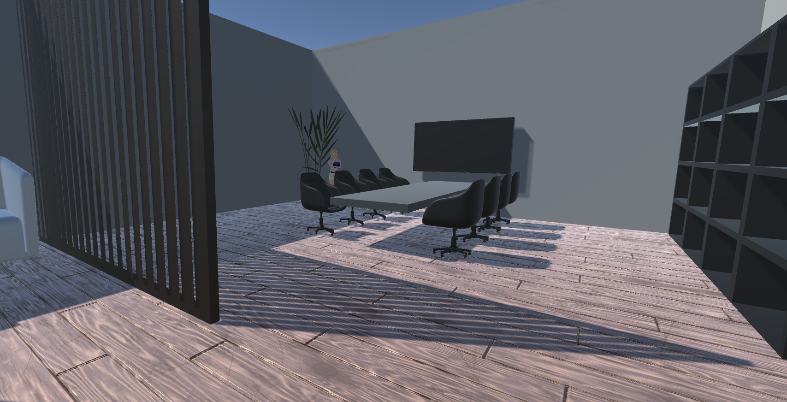
Modelling - Environment

Slide 4
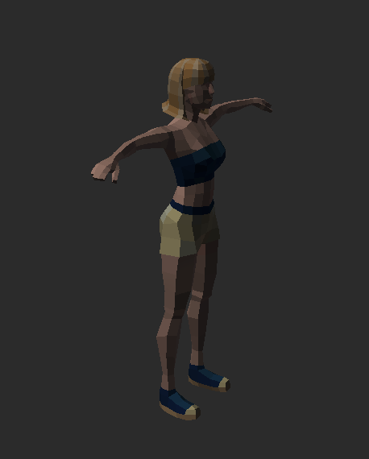
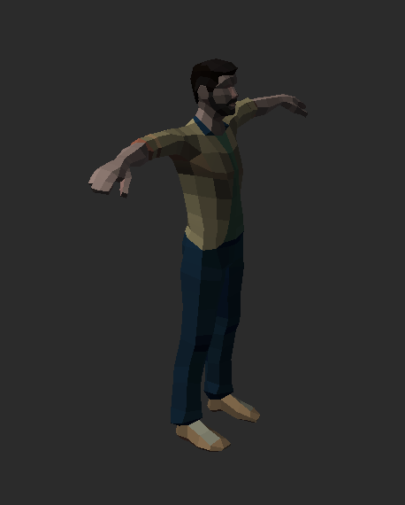
Characters

Slide 5
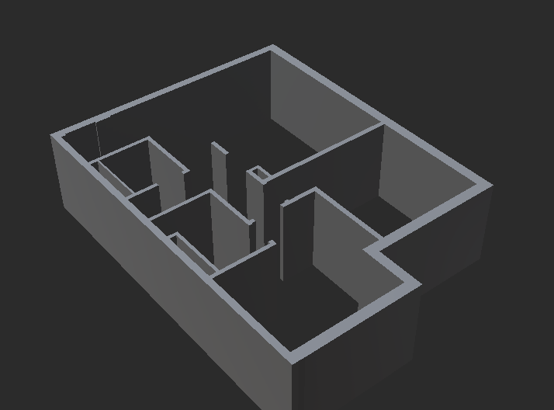
Room environment
Multiple rooms for virtual meets on map 1

Slide 6
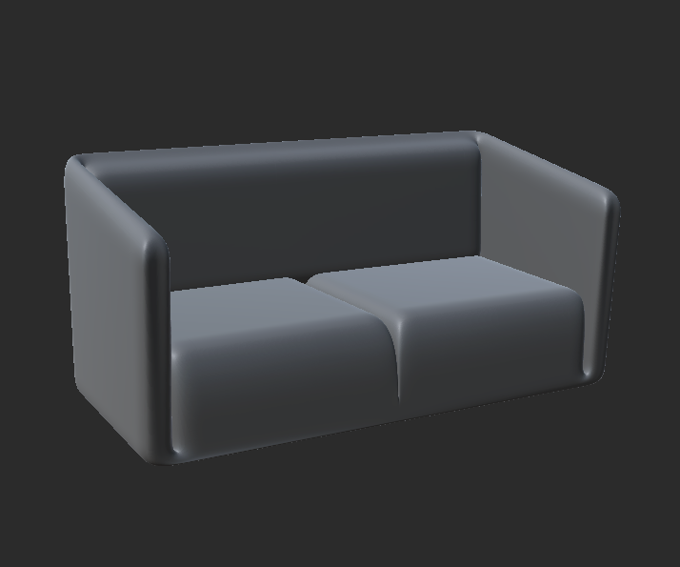
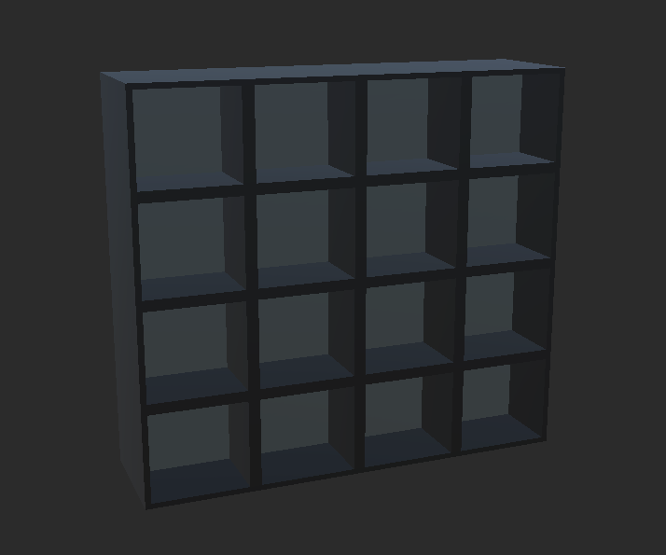
Furniture

Slide 7
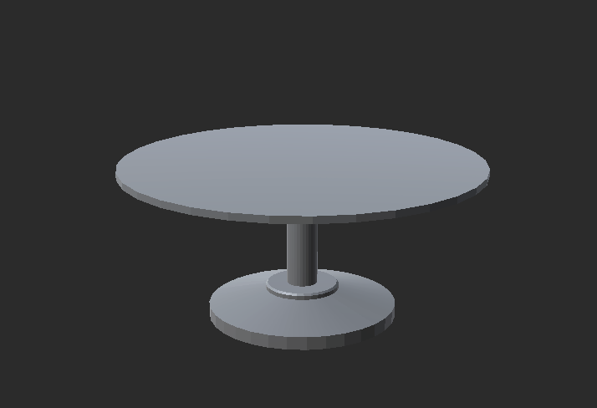
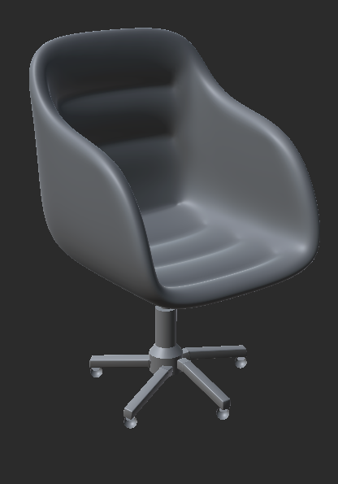
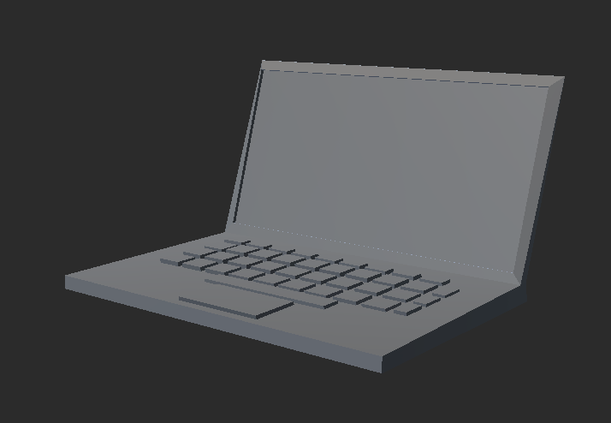
Other objects

Slide 8
App logic
The app is designed as a multiplayer game where players can meet and interact with each other
For this we are using a server application, build from unity as “dedicated server” and client application, of “windows/mac/linux” types. The same code is used for both systems, and it detects whether or not it should start as a host (in server mode), or as a client and connect to it.

